Slide 1
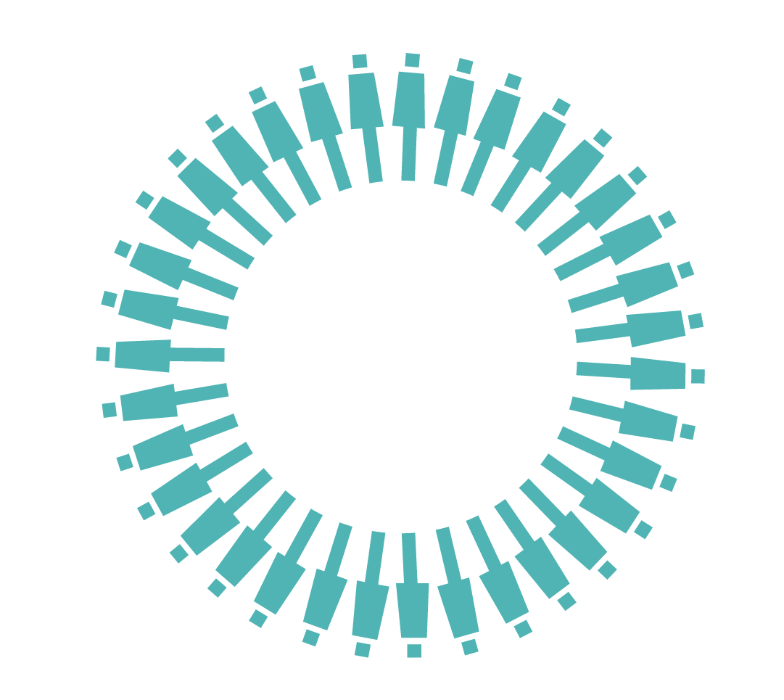
Osteoarthritis

Slide 2
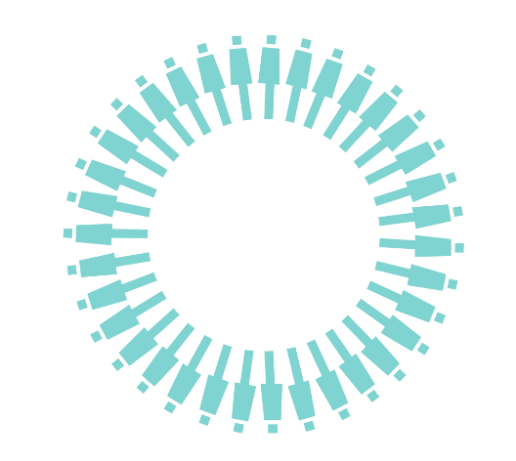
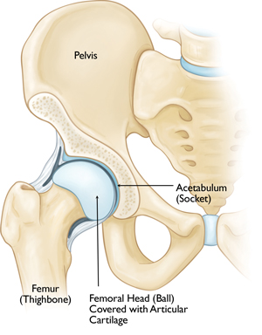
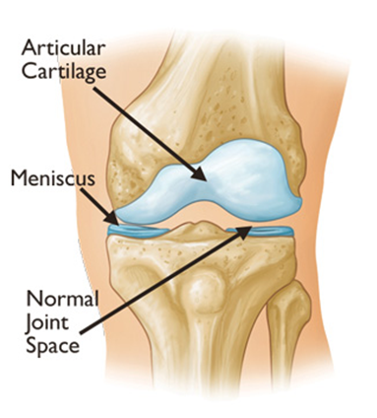
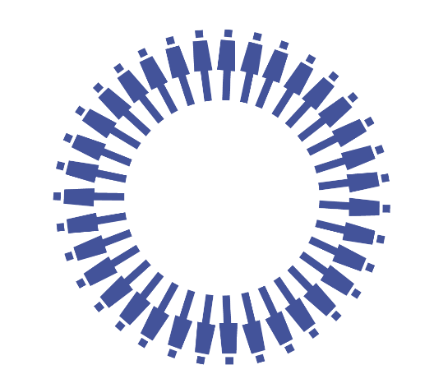
What is Osteoarthritis? No arthritic changes:
Notes:
Most common form of arthritis
A condition that affects the joints causing pain and stiffness
Commonly known as wear and tear arthritis
Normal knee and hip joint:
The hip joint is a ball and socket joint which connects the thigh bone to the pelvis.
The knee is a hinge joint which connects the thigh and shin
Articular surfaces covered in cartilage.
Knee has two extra discs of cartilage called meniscus.
Stability gained from muscles, shape of bones, cartilage, ligaments.
What happens with OA?
Cartilage gradually roughens and can become thinner.
The bone underneath becomes thicker and bony spurs can form
The capsule and ligaments slowly thicken- can restrict movement
All structures are more active than normal- as if they are trying to repair- this can be why have flare ups.
Tissues can become inflamed as a result of repair process and as such swelling.
Less effective properties of synovial fluid- less lubrication
What this means?
Muscles may not work as effectively as before due to pain inhibition
Thining of cartilage – less cushioning for joint surfaces and less stability.
Less viscous synovial fluid- less lubrication and protection of joint surfaces
Swelling
Deformity can develop due to uneven wearing
Decreased movement due to thickening of structures ?to try to gain stability

Slide 3
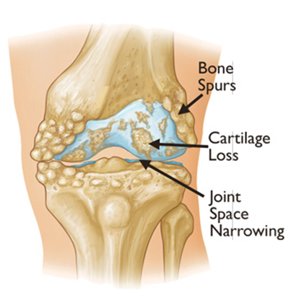
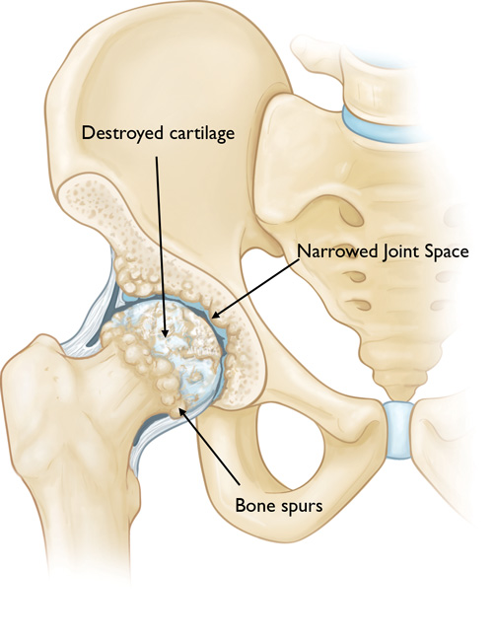
What is Osteoarthritis? Significant arthritic changes:
Notes:
Most common form of arthritis
A condition that affects the joints causing pain and stiffness
Commonly known as wear and tear arthritis
Normal knee and hip joint:
The hip joint is a ball and socket joint which connects the thigh bone to the pelvis.
The knee is a hinge joint which connects the thigh and shin
Articular surfaces covered in cartilage.
Knee has two extra discs of cartilage called meniscus.
Stability gained from muscles, shape of bones, cartilage, ligaments.
What happens with OA?
Cartilage gradually roughens and can become thinner.
The bone underneath becomes thicker and bony spurs can form
The capsule and ligaments slowly thicken- can restrict movement
All structures are more active than normal- as if they are trying to repair- this can be why have flare ups.
Tissues can become inflamed as a result of repair process and as such swelling.
Less effective properties of synovial fluid- less lubrication
What this means?
Muscles may not work as effectively as before due to pain inhibition
Thining of cartilage – less cushioning for joint surfaces and less stability.
Less viscous synovial fluid- less lubrication and protection of joint surfaces
Swelling
Deformity can develop due to uneven wearing
Decreased movement due to thickening of structures ?to try to gain stability

Slide 4
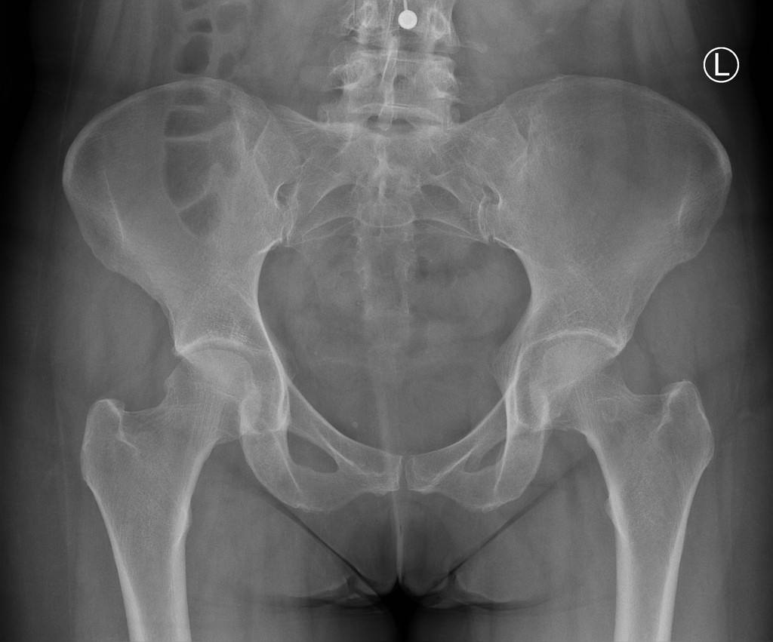
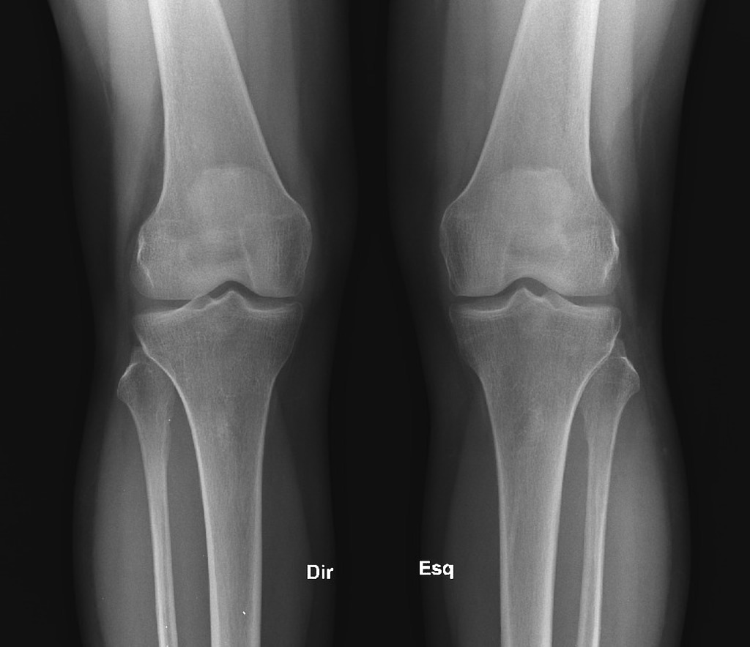
How does an X-ray help?
X-rays can be helpful with diagnosing Osteoarthritis but they don’t always predict pain
Notes:
Most common form of arthritis
A condition that affects the joints causing pain and stiffness
Commonly known as wear and tear arthritis
Normal knee and hip joint:
The hip joint is a ball and socket joint which connects the thigh bone to the pelvis.
The knee is a hinge joint which connects the thigh and shin
Articular surfaces covered in cartilage.
Knee has two extra discs of cartilage called meniscus.
Stability gained from muscles, shape of bones, cartilage, ligaments.
What happens with OA?
Cartilage gradually roughens and can become thinner.
The bone underneath becomes thicker and bony spurs can form
The capsule and ligaments slowly thicken- can restrict movement
All structures are more active than normal- as if they are trying to repair- this can be why have flare ups.
Tissues can become inflamed as a result of repair process and as such swelling.
Less effective properties of synovial fluid- less lubrication
What this means?
Muscles may not work as effectively as before due to pain inhibition
Thining of cartilage – less cushioning for joint surfaces and less stability.
Less viscous synovial fluid- less lubrication and protection of joint surfaces
Swelling
Deformity can develop due to uneven wearing
Decreased movement due to thickening of structures ?to try to gain stability

Slide 5
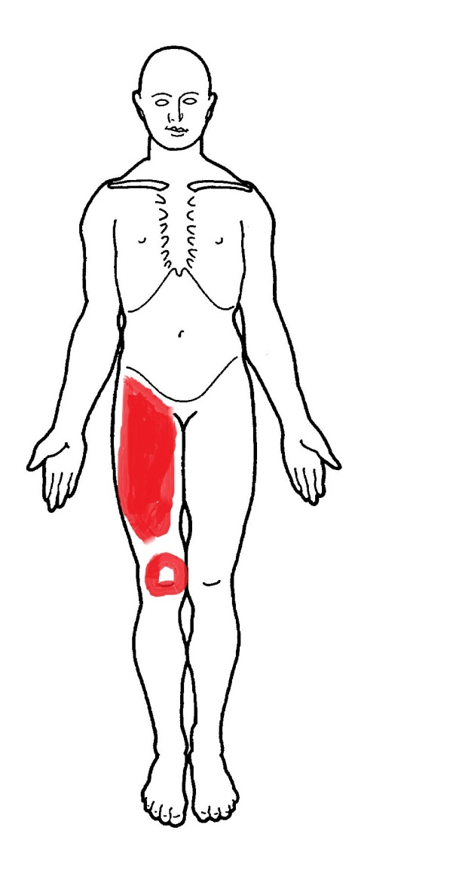
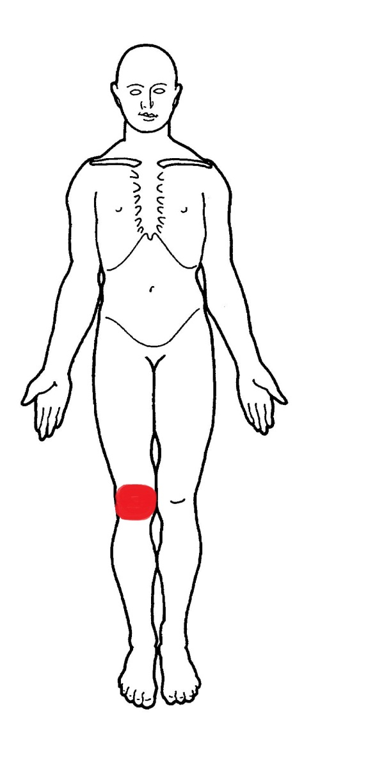
Symptoms
Painful/aching knee
Groin/ front of thigh and knee pain possible (referred pain
Stiffness in the knee in the morning or after rest, or after prolonged sitting or weight bearing
With severe OA there may be a restriction in movement/walking distance
The knee may give way due to weak thigh muscles
Reduced range of movement
Increased pain during the winter months
Difficulty with functional tasks e.g. socks
Notes:
Morning pain and stiffness
Pain with weight bearing
Pain after prolonged sitting
Reduced range of movement
Hip OA- pain commonly in groin, front of thigh and in hip and sometimes in knee
Knee OA- pain anywhere around knee but commonly on joint line.

Slide 6
Risk Factors
Age
High BMI
Previous joint injury
Previous surgical intervention
Family history
Gender
Other conditions (secondary arthritis)
Notes:
Age – not fully understood but maybe due to body less able to heal itself with age and muscles become weaker.
Previous joint injury – overusing your joints, excessive or repetative activity or previous injury to joints
Previous Surgical Intervention – Arthroscopy increases the risk of a TKR by 3x
Obesity – being obese puts excess strain on your joints, and less likely to be active
Family history – osteoarthritis may run in families, although studies haven't identified a single gene responsible
Other conditions (secondary arthritis) – osteoarthritis can occur in joints damaged by a previous or existing condition, such as rheumatoid arthritis or Gout
Gender- more prevalent in females

Slide 7
Management
Self Management
No Intervention
Conservative Management
Surgery
Rehab & Recovery
Notes:
Once you have osteoarthritis you cant get rid of the condition.
It doesn’t always progress.
However you can manage the condition
Exercise
Pain killers
Amending activities
Walking aids
Appropriate footwear
Weight control
In severe cases of OA, joint replacement is sometimes considered.
This is major surgery and recovery from it requres a lot of input form the patient

Slide 8
Useful Contacts
Useful Contacts
Podiatry
01473 275204
Community Team
03330 123 2425
Red Cross
03330 456 1155

