Slide 1
Managing your pain

Slide 2
Introduction
Looking at areas of pain
What is pain?
Pacing
Managing pain

Slide 3
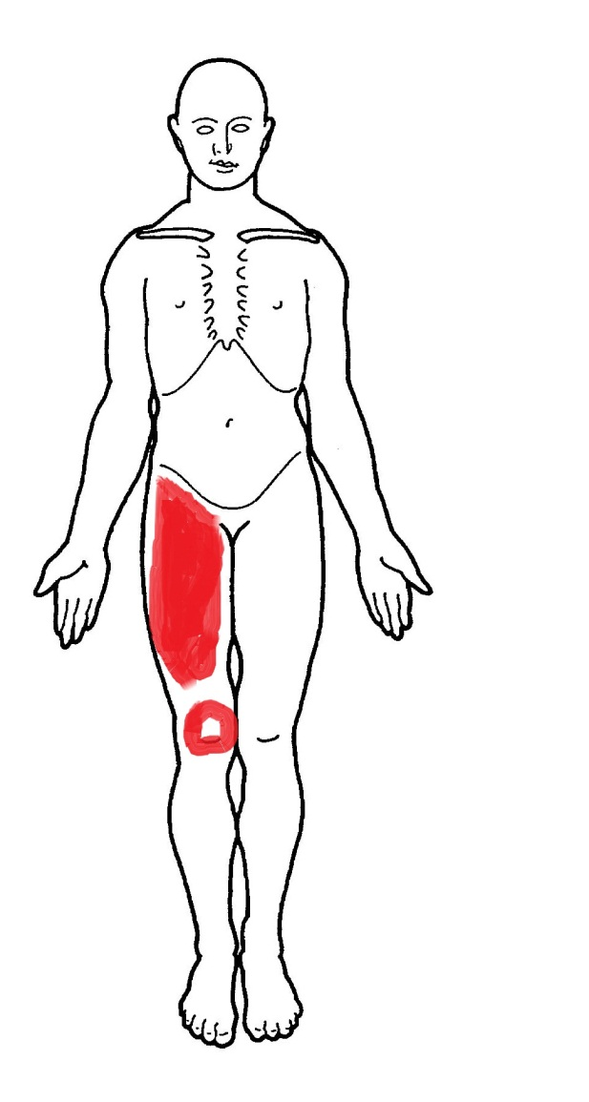
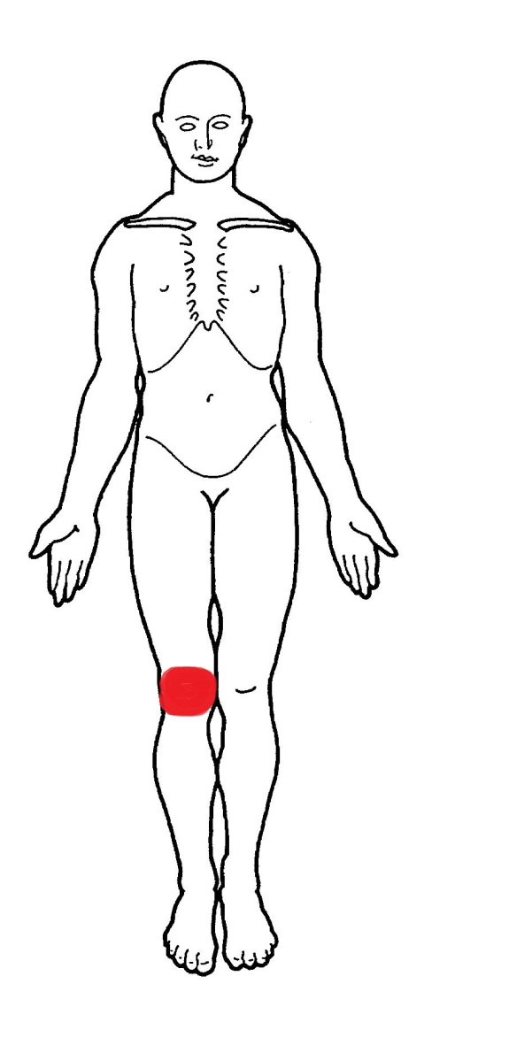
Areas of pain
Hip Pain
The painful areas are usually the lower back, buttocks and groin. Some people also feel discomfort from the top of their thigh down to the knee. Sometimes it can even be felt all the way down to the ankle. This can be known as referred or radiating pain.
Knee Pain
The pain can be felt all around your knee, or just in a certain place such as the front and sides. It might feel worse after moving your knee in a particular way, such as going up or down stairs.
Text 003

Slide 4
Sensory
Cognitive
Behaviour
Pain
Acute pain (short term)
Immediate & intense
Useful alarm signal to promote rest and healing
Minimal long term impact
Chronic pain (persistent/long term)
Persists beyond tissue healing time
Increased sensitivity of the nervous system to pain
Associated with a range of emotions
Text 003

Slide 5
Pain Cycle
Painful Joints
Less Active
Weaker Muscles
Joints feel unstable
More pain when moving Joints
It is common to avoid exercise when joints are feeling painful and stiff, however inactivity can lead to what is called the pain or deconditioned cycle.
During this, muscles become weaker, joint pain and stiffness increases and mobility can be impaired.
Regular exercise is vital and can help reduce pain.
Remember it is natural to feel some discomfort during exercise but this does not mean it is causing damage to joints
Begin gradually and build up slowly
Text 003
Notes:
Extending on the aspect of pain – going into more detail as to how this can affect day to day life and relating this to the pain cycle.

Slide 6
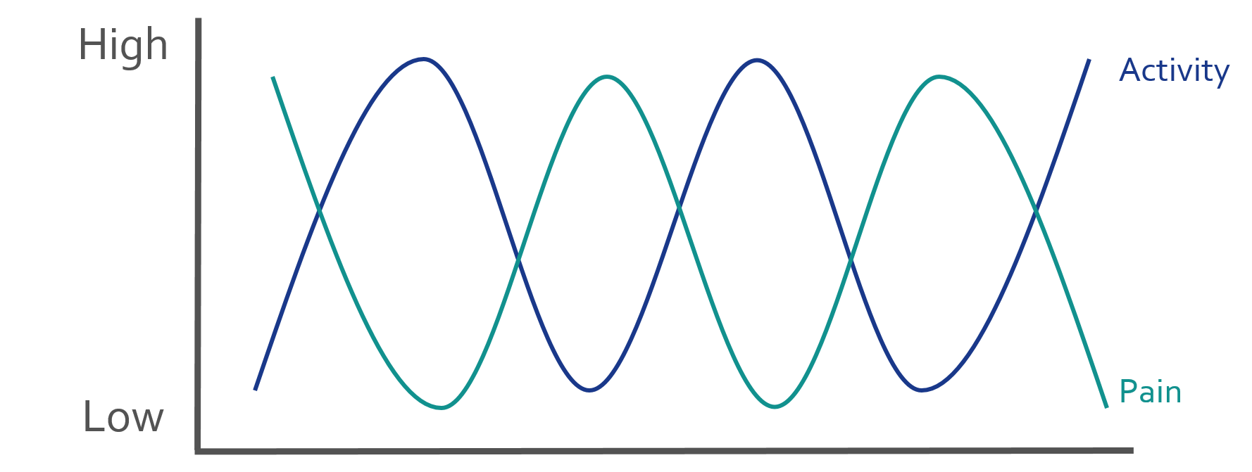
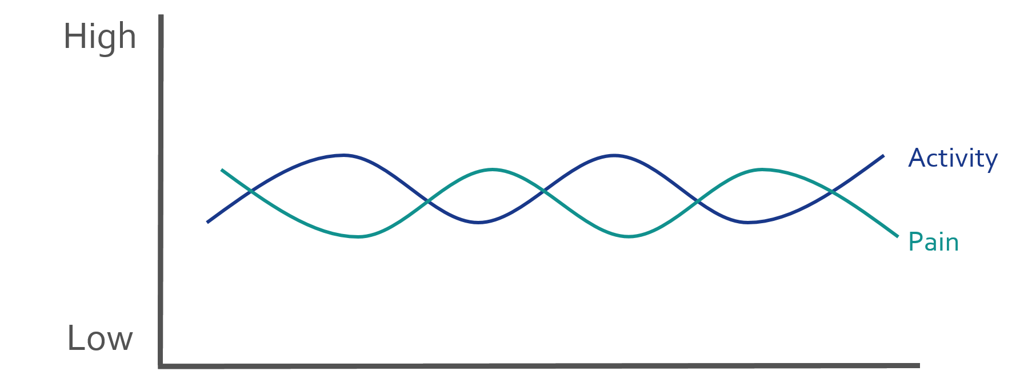
Pacing
The key to managing pain is
Learning to recognise how much you can do at once without causing a flare up.
Performing activities in a manageable way
Text 003

Slide 7
How to pace
MEASURING – average time before symptoms become significantly worse
SET QUOTA – i.e. reduce time by 20%
STICK TO YOUR QUOTA – can be difficult
INCREASE THE QUOTA – g r a d u a l l y
Text 003

Slide 8
Managing Pain
There are various ways to manage pain, as previously discussed staying physically active along with being mindful of pacing is essential to pain management.
Additional methods that may help reduce pain include :
Heat/Ice - Most commonly heat is used when a joint is feeling stiff and ice when a joint is inflamed. However, there is no set rule to which should be used, this may come down to preference of the individual.
Painkillers - Medication should be taken as prescribed from your GP
Gels - Anti-inflammatory gels are commonly used to reduce inflammation, they can be brought over the counter or prescribed. Ask advice from your pharmacist or GP before using
Supportive devices – There are a variety of devices available to aid in mobility and everyday tasks.
Managing pain
Painkillers
Heat/Ice
Gels
Pacing
Supportive Devices
Staying active
Text 003

